Slide 1
物件導向設計
Defining Classes II
授課教師:陳錫民
Email: hsiminc@fcu.edu.tw

Slide 2
Static Methods
A static method is one that can be used without a calling object
A static method still belongs to a class, and its definition is given inside the class definition
When a static method is defined, the keyword static is placed in the method header
public static returnedType myMethod(parameters)
{ . . . }
Static methods are invoked using the class name in place of a calling object
returnedValue = MyClass.myMethod(arguments);

Slide 3
Pitfall: Invoking a Nonstatic Method Within a Static Method
A static method CANNOT refer to an member variable of the class, and it cannot invoke a nonstatic method of the class
A static method has no this, so it cannot use an member variable or method that has an implicit or explicit this for a calling object
A static method can invoke another static method

Slide 4
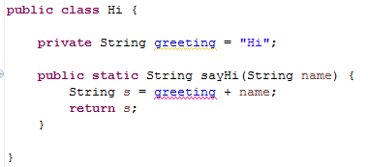
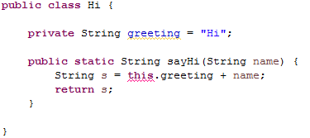
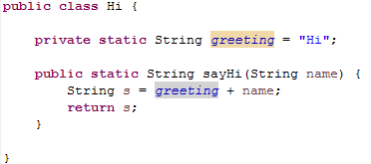
Pitfall: Invoking a Nonstatic Method Within a Static Method

Slide 5
Tip: You Can Put a main in any Class
Although the main method is often by itself in a class separate from the other classes of a program, it can also be contained within a regular class definition
In this way the class in which it is contained can be used to create objects in other classes, or it can be run as a program
A main method so included in a regular class definition is especially useful when it contains diagnostic code for the class

Slide 6
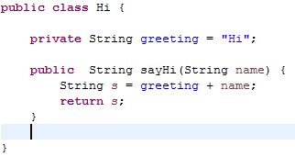
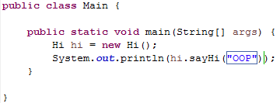
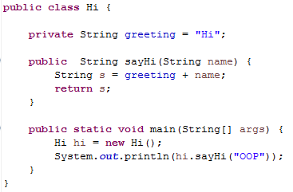
Tip: You Can Put a main in any Class

Slide 7
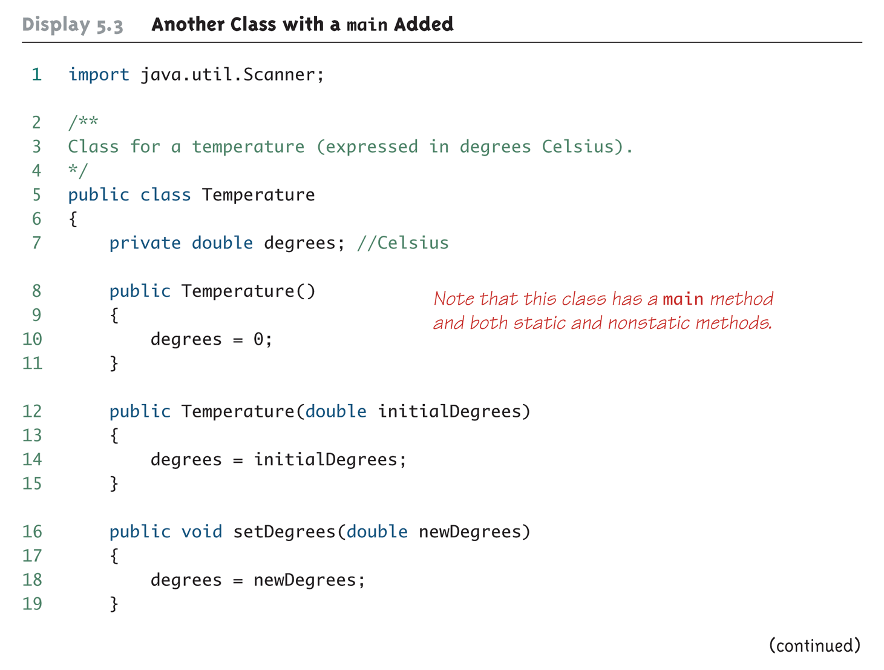
Another Class with a main Added (Part 1 of 4)

Slide 8
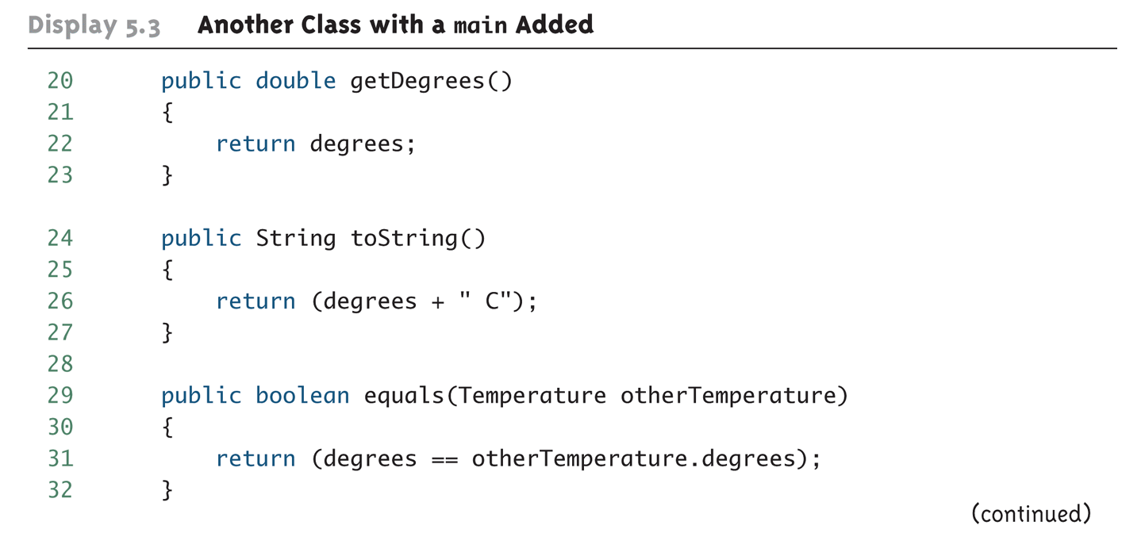
Another Class with a main Added (Part 2 of 4)

Slide 9
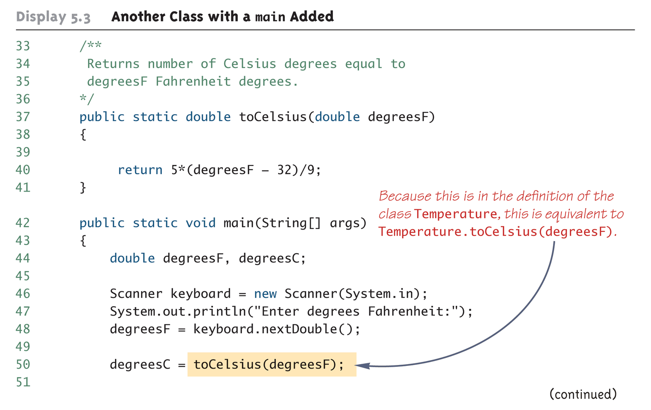
Another Class with a main Added (Part 3 of 4)

Slide 10
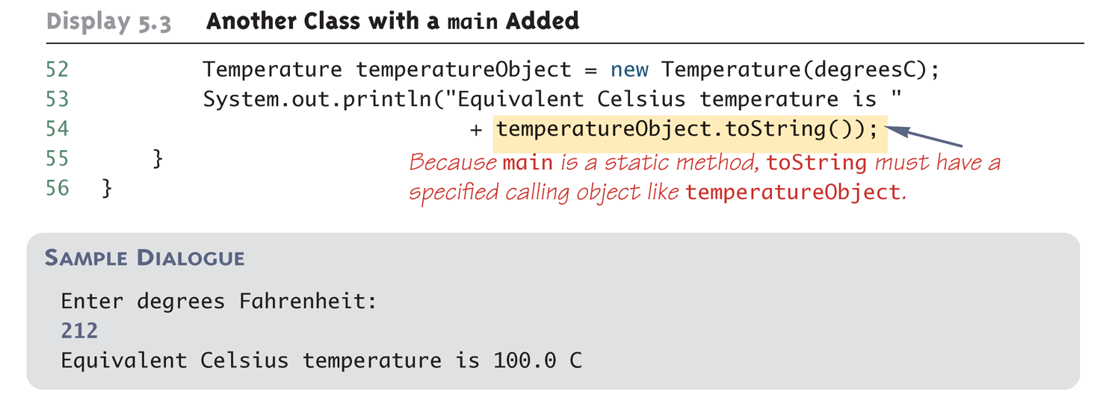
Another Class with a main Added (Part 4 of 4)

Slide 11
Static Variables
A static variable is a variable that belongs to the class as a whole, and NOT just to one object
There is only one copy of a static variable per class, unlike instance variables where each object has its own copy
All objects of the class can read and change a static variable
Although a static method cannot access an instance variable, a static method can access a static variable
A static variable is declared like an instance variable, with the addition of the modifier static
private static int myStaticVariable;

Slide 12
Static Variables
Static variables can be declared and initialized at the same time
private static int myStaticVariable = 0;
If not explicitly initialized, a static variable will be automatically initialized to a default value
boolean static variables are initialized to false
Other primitive types static variables are initialized to the zero of their type
Class type static variables are initialized to null
It is always preferable to explicitly initialize static variables rather than rely on the default initialization

Slide 13
Static Variables
A static variable should always be defined private, unless it is also a defined constant
The value of a static defined constant CANNOT be altered, therefore it is safe to make it public
In addition to static, the declaration for a static defined constant must include the modifier final, which indicates that its value CANNOT be changed
public static final int BIRTH_YEAR = 1954;
When referring to such a defined constant outside its class, use the name of its class in place of a calling object
int year = MyClass.BIRTH_YEAR;

Slide 14
The Math Class
The Math class provides a number of standard mathematical methods
It is found in the java.lang package, so it does not require an import statement
All of its methods and data are static, therefore they are invoked with the class name Math instead of a calling object
The Math class has two predefined constants, E (e, the base of the natural logarithm system) and PI (π, 3.1415 . . .)
area = Math.PI * radius * radius;

Slide 15
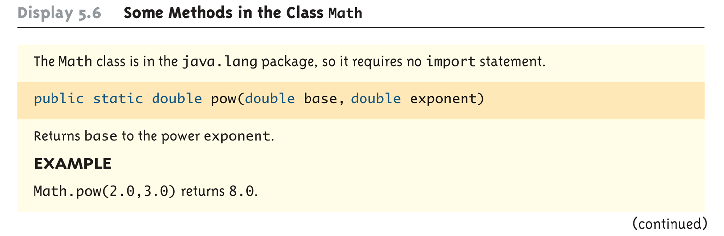
Some Methods in the Class Math (Part 1 of 5)

Slide 16
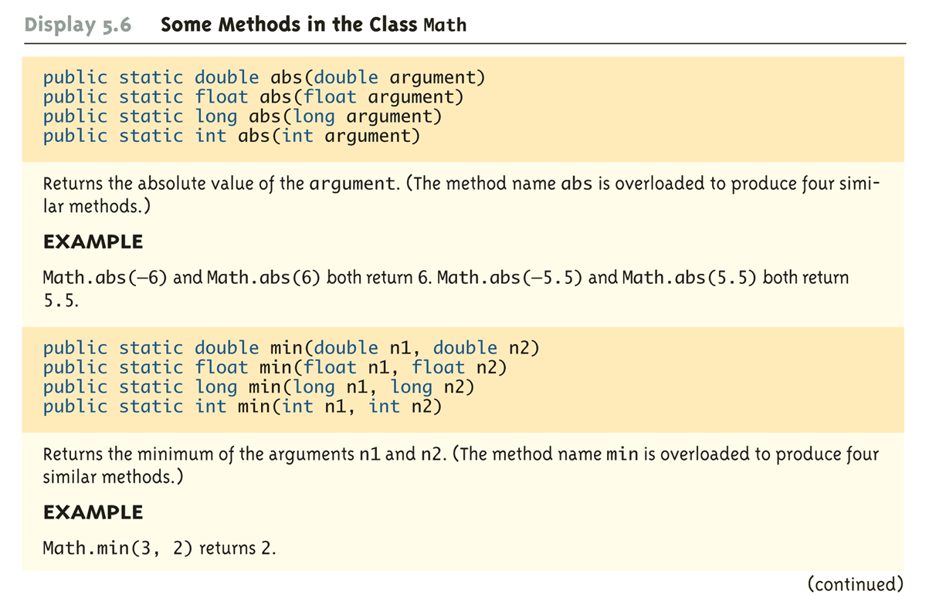
Some Methods in the Class Math (Part 2 of 5)

Slide 17
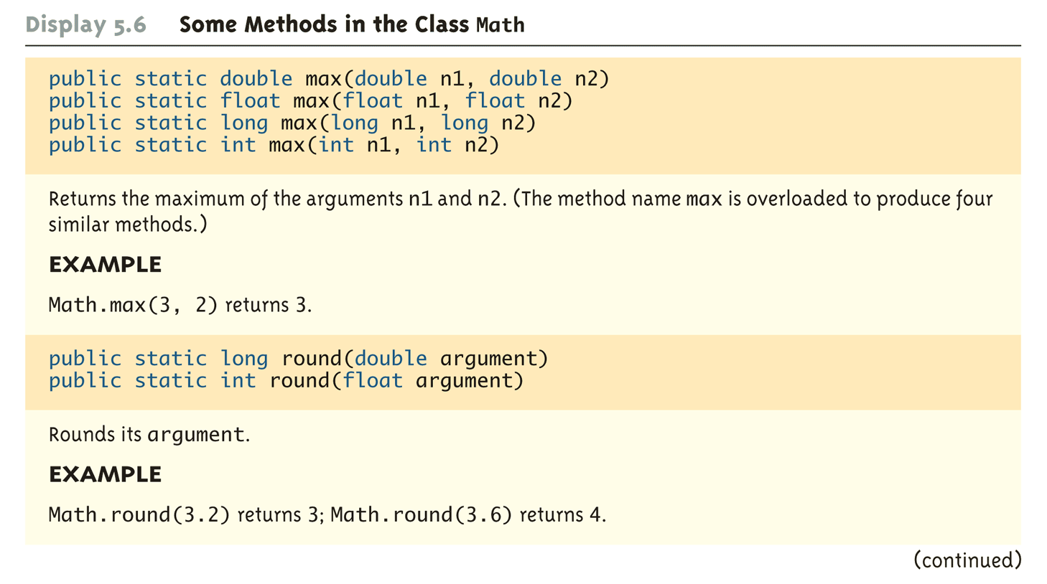
Some Methods in the Class Math (Part 3 of 5)

Slide 18
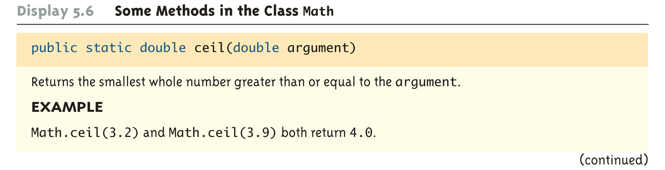
Some Methods in the Class Math (Part 4 of 5)

Slide 19
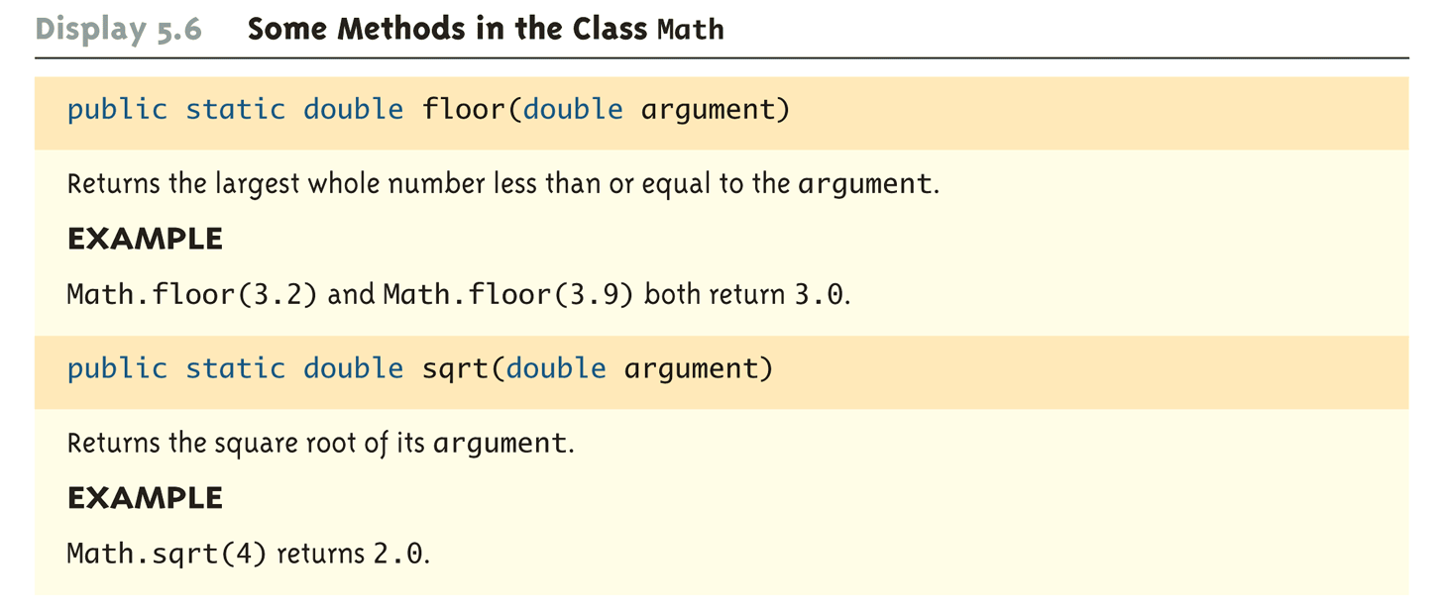
Some Methods in the Class Math (Part 5 of 5)

Slide 20
Random Numbers
The Math class also provides a facility to generate pseudo-random numbers
A pseudo-random number appears random but is really generated by a deterministic function
There is also a more flexible class named Random
Sample use:
Returns a pseudo-random number greater than or equal to 0.0 and less than 1.0
public static double random()
double num = Math.random();

Slide 21
Wrapper Classes
Wrapper classes provide a class type corresponding to each of the primitive types
This makes it possible to have class types that behave somewhat like primitive types
The wrapper classes for the primitive types byte, short, long, float, double, and char are (in order) Byte, Short, Long, Float, Double, and Character
Wrapper classes also contain a number of useful predefined constants and static methods

Slide 22
Wrapper Classes
Boxing: the process of going from a value of a primitive type to an object of its wrapper class
To convert a primitive value to an "equivalent" class type value, create an object of the corresponding wrapper class using the primitive value as an argument
The new object will contain an instance variable that stores a copy of the primitive value
Unlike most other classes, a wrapper class does not have a no-argument constructor
Integer integerObject = new Integer(42);

Slide 23
Wrapper Classes
Unboxing: the process of going from an object of a wrapper class to the corresponding value of a primitive type
The methods for converting an object from the wrapper classes Byte, Short, Integer, Long, Float, Double, and Character to their corresponding primitive type are (in order) byteValue, shortValue, intValue, longValue, floatValue, doubleValue, and charValue
None of these methods take an argument
int i = integerObject.intValue();

Slide 24
Automatic Boxing and Unboxing
Starting with version 5.0, Java can automatically do boxing and unboxing
Instead of creating a wrapper class object using the new operation (as shown before), it can be done as an automatic type cast:
Integer integerObject = 42;
Instead of having to invoke the appropriate method (such as intValue, doubleValue, charValue, etc.) in order to convert from an object of a wrapper class to a value of its associated primitive type, the primitive value can be recovered automatically
int i = integerObject;

Slide 25
Constants and Static Methods in Wrapper Classes
Wrapper classes include useful constants that provide the largest and smallest values for any of the primitive number types
For example, Integer.MAX_VALUE, Integer.MIN_VALUE, Double.MAX_VALUE, Double.MIN_VALUE, etc.
The Boolean class has names for two constants of type Boolean
Boolean.TRUE and Boolean.FALSE are the Boolean objects that correspond to the values true and false of the primitive type boolean

Slide 26
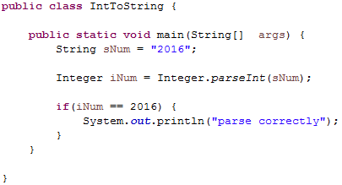
Constants and Static Methods in Wrapper Classes
Wrapper classes have static methods that convert a correctly formed string representation of a number to the number of a given type
The methods Integer.parseInt, Long.parseLong, Float.parseFloat, and Double.parseDouble do this for the primitive types (in order) int, long, float, and double

Slide 27
Constants and Static Methods in Wrapper Classes
Wrapper classes also have static methods that convert from a numeric value to a string representation of the value
For example, the expression
Double.toString(123.99);
returns the string value "123.99"
The Character class contains a number of static methods that are useful for string processing

Slide 28
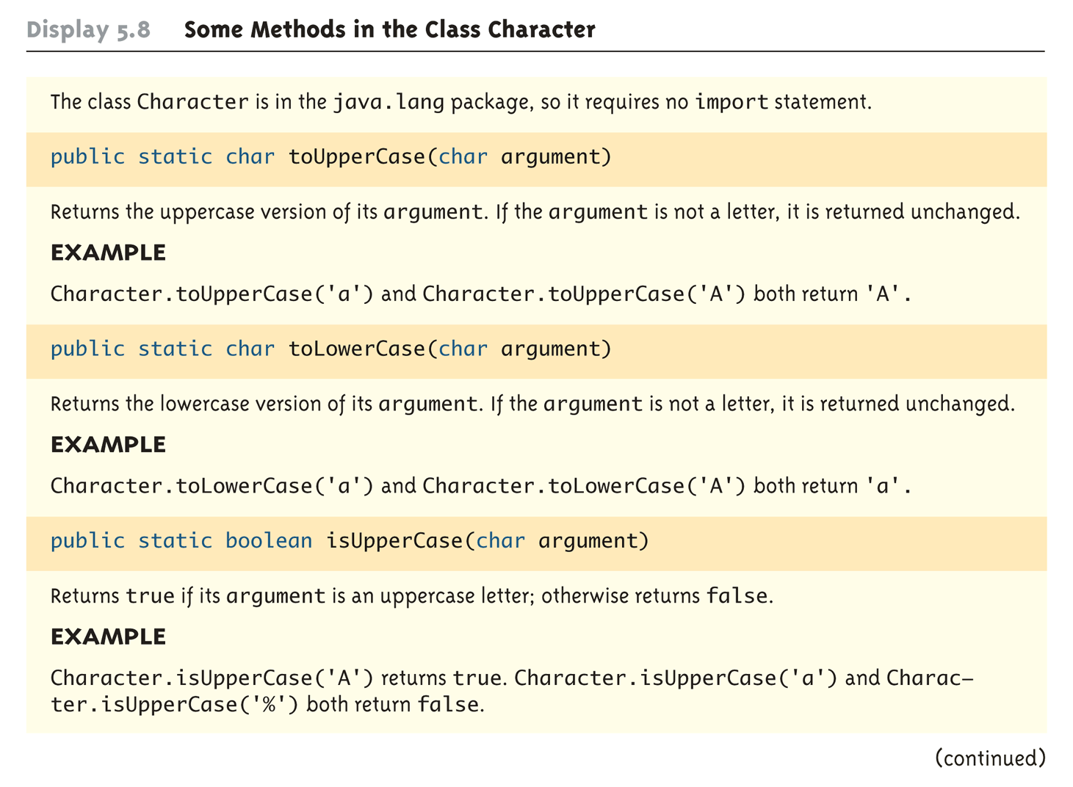
Some Methods in the Class Character (Part 1 of 3)

Slide 29
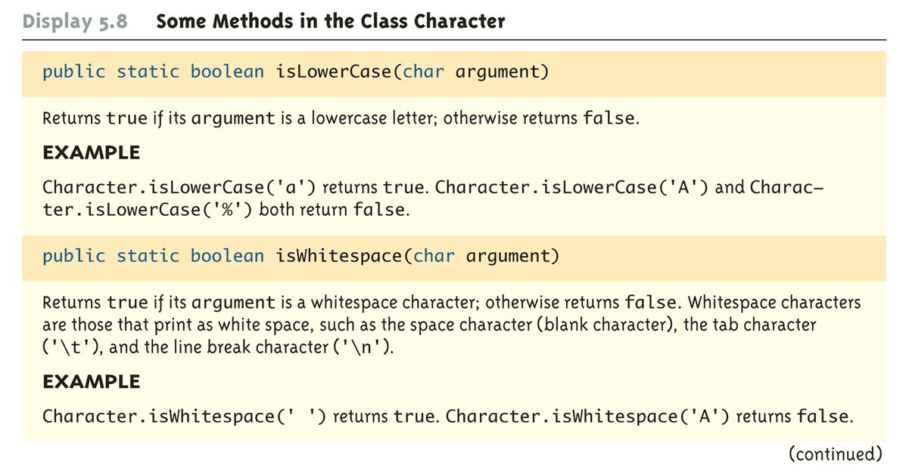
Some Methods in the Class Character (Part 2 of 3)

Slide 30
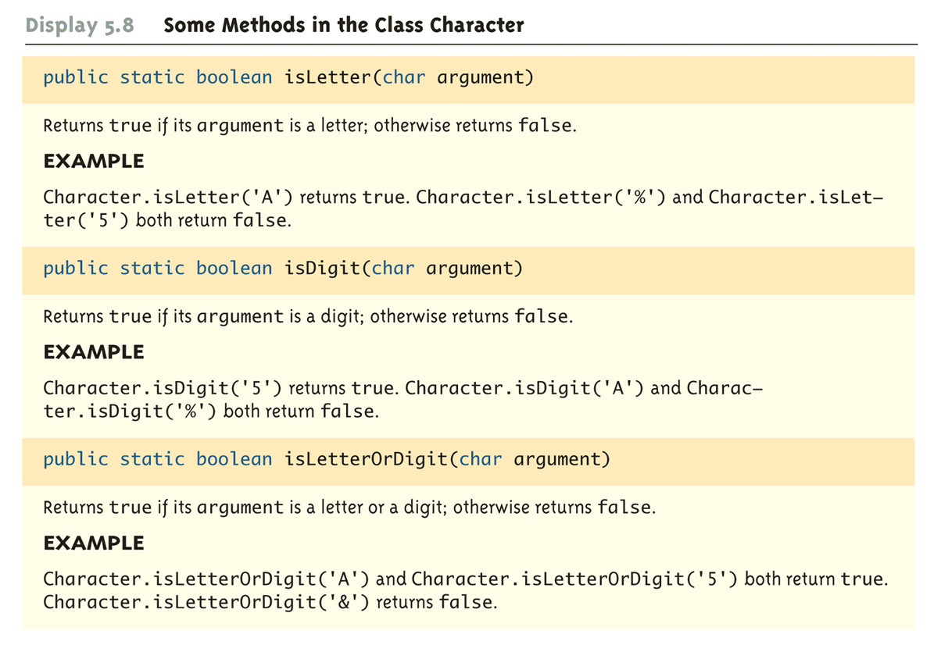
Some Methods in the Class Character (Part 3 of 3)

Slide 31
Variables and Memory
A computer has two forms of memory
Secondary memory is used to hold files for "permanent" storage
Main memory is used by a computer when it is running a program
Values stored in a program's variables are kept in main memory

Slide 32
Variables and Memory
Main memory consists of a long list of numbered locations called bytes
Each byte contains eight bits: eight 0 or 1 digits
The number that identifies a byte is called its address
A data item can be stored in one (or more) of these bytes
The address of the byte is used to find the data item when needed

Slide 33
Variables and Memory
Values of most data types require more than one byte of storage
Several adjacent bytes are then used to hold the data item
The entire chunk of memory that holds the data is called its memory location
The address of the first byte of this memory location is used as the address for the data item
A computer's main memory can be thought of as a long list of memory locations of varying sizes

Slide 34
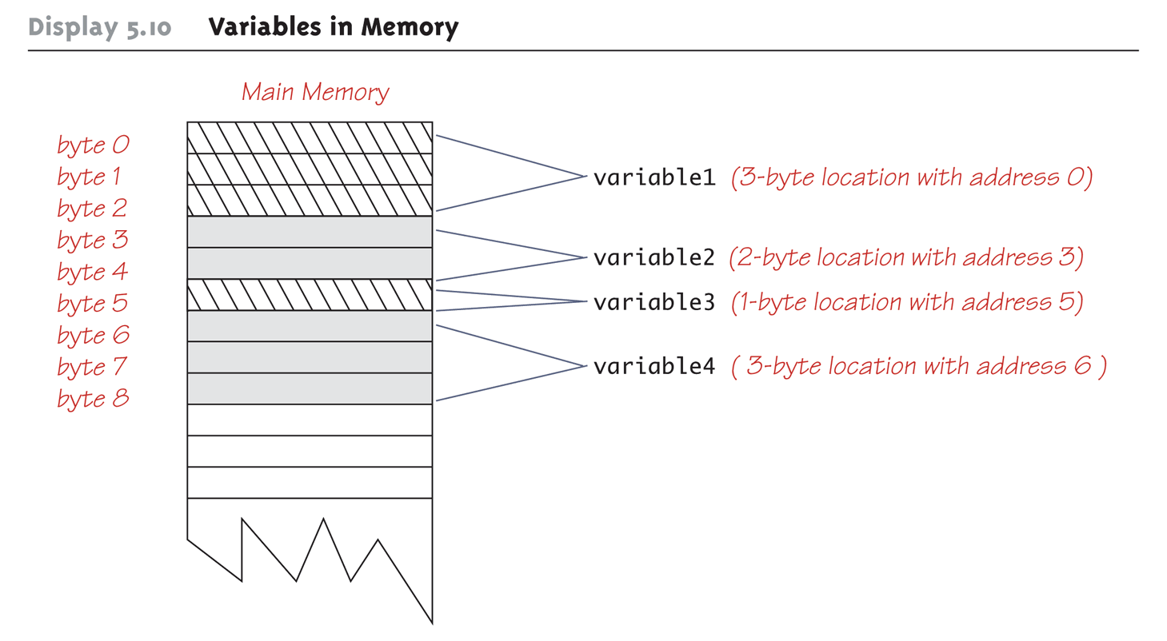
Variables in Memory

Slide 35
References
Every variable is implemented as a location in computer memory
When the variable is a primitive type, the value of the variable is stored in the memory location assigned to the variable
Each primitive type always require the same amount of memory to store its values

Slide 36
References
When the variable is a class type, only the memory address (or reference) where its object is located is stored in the memory location assigned to the variable
The object named by the variable is stored in some other location in memory
Like primitives, the value of a class variable is a fixed size
Unlike primitives, the value of a class variable is a memory address or reference
The object, whose address is stored in the variable, can be of any size

Slide 37
References
Two reference variables can contain the same reference, and therefore name the same object
The assignment operator sets the reference (memory address) of one class type variable equal to that of another
Any change to the object named by one of theses variables will produce a change to the object named by the other variable, since they are the same object
variable2 = variable1;

Slide 38
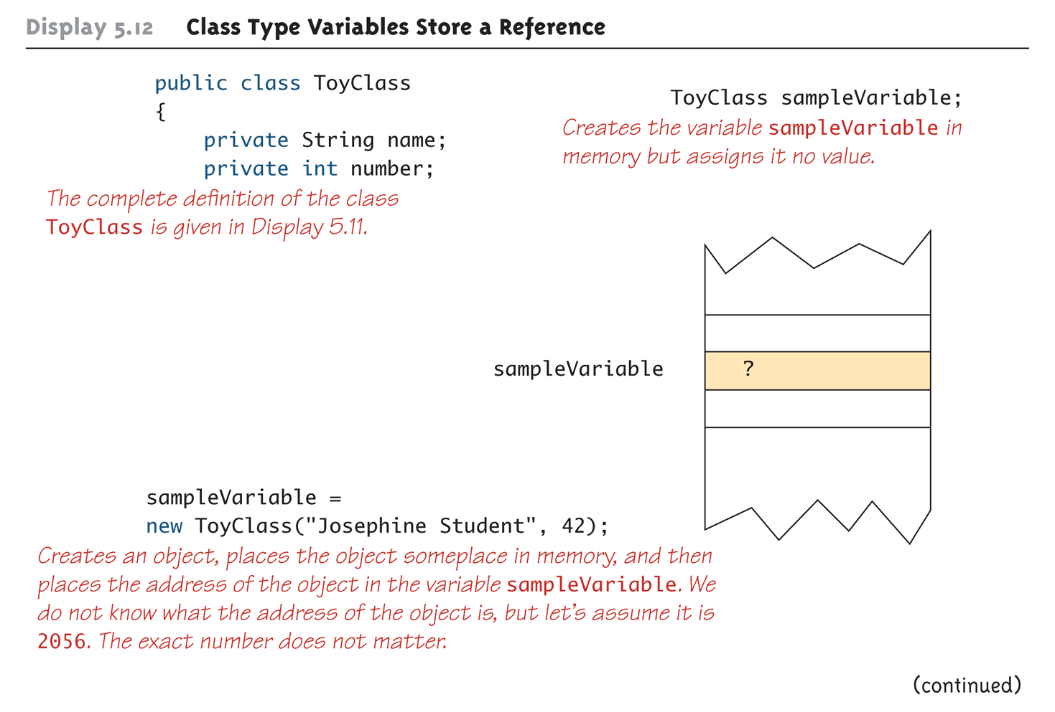
Class Type Variables Store a Reference (Part 1 of 2)

Slide 39
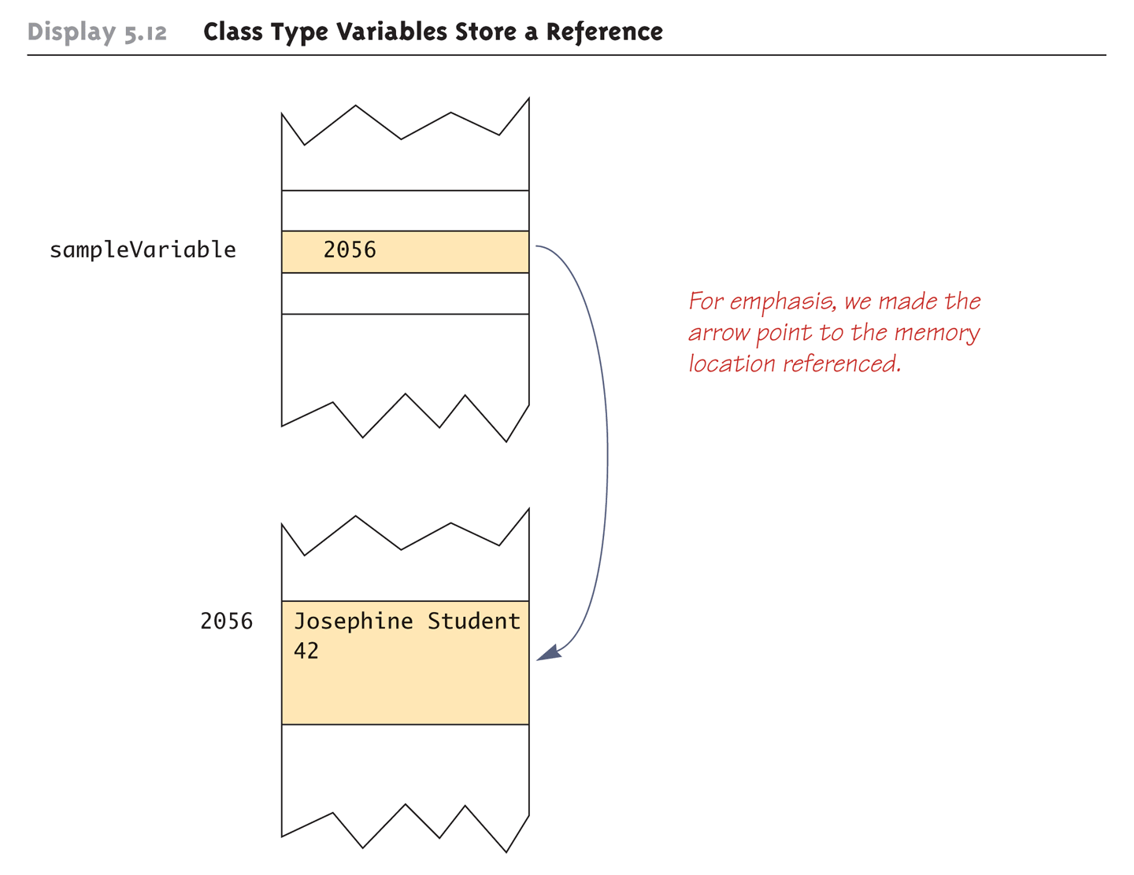
Class Type Variables Store a Reference (Part 2 of 2)

Slide 40
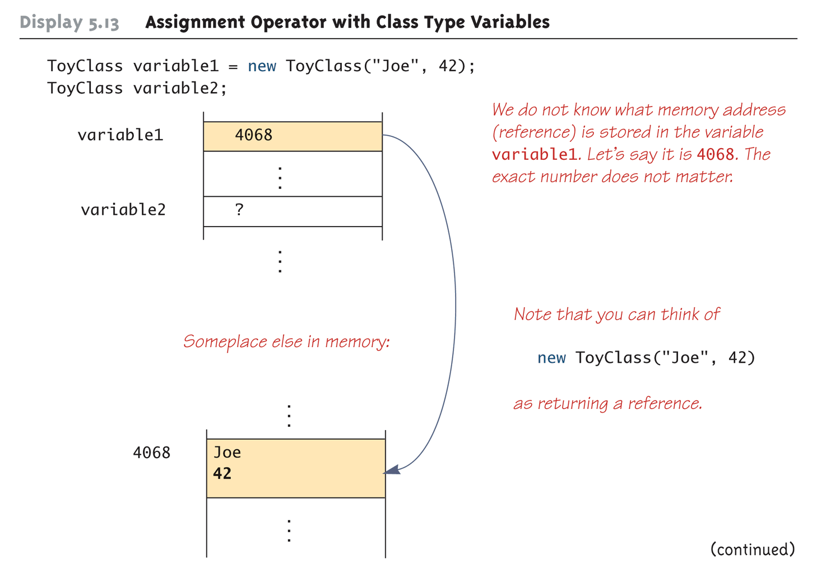
Assignment Operator with Class Type Variables (Part 1 of 3)

Slide 41
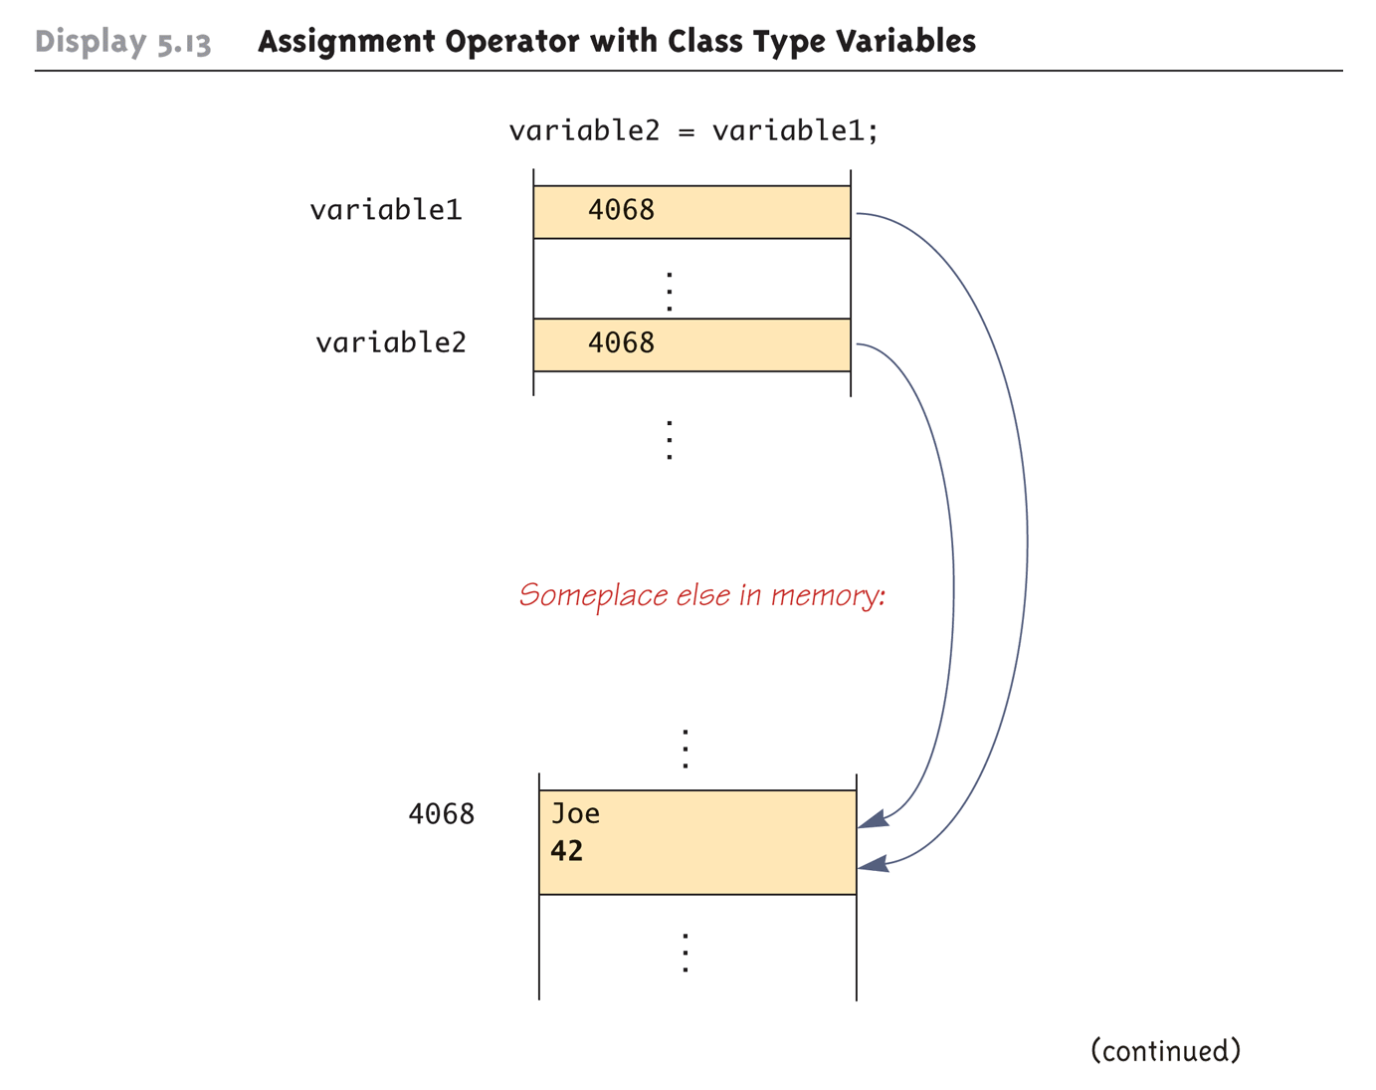
Assignment Operator with Class Type Variables (Part 2 of 3)

Slide 42
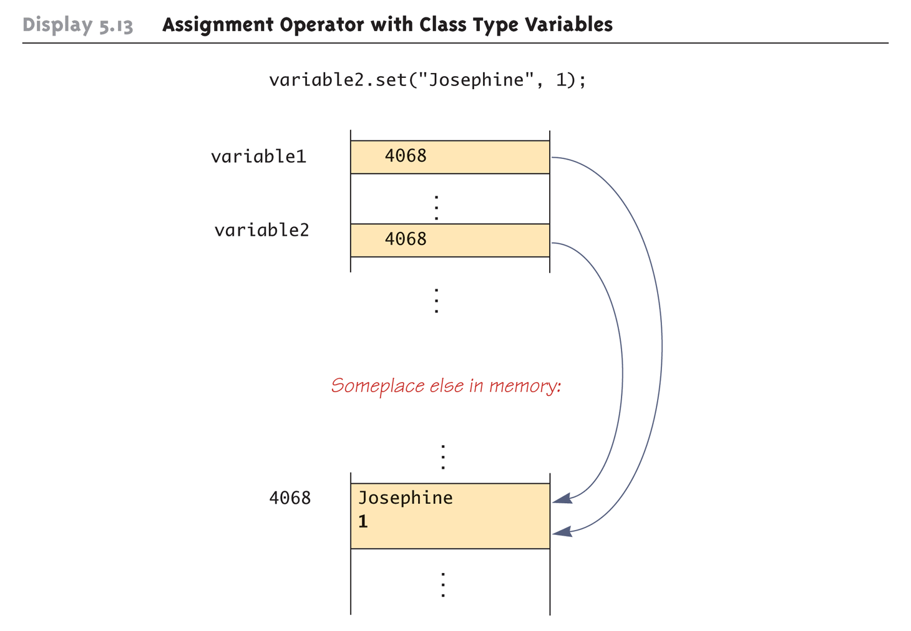
Assignment Operator with Class Type Variables (Part 3 of 3)

Slide 43
Class Parameters
All parameters in Java are call-by-value parameters
A parameter is a local variable that is set equal to the value of its argument
Therefore, any change to the value of the parameter cannot change the value of its argument
Class type parameters appear to behave differently from primitive type parameters
They appear to behave in a way similar to parameters in languages that have the call-by-reference parameter passing mechanism

Slide 44
Class Parameters
The value plugged into a class type parameter is a reference (memory address)
Therefore, the parameter becomes another name for the argument
Any change made to the object named by the parameter (i.e., changes made to the values of its instance variables) will be made to the object named by the argument, because they are the same object
Note that, because it still is a call-by-value parameter, any change made to the class type parameter itself (i.e., its address) will not change its argument (the reference or memory address)

Slide 45
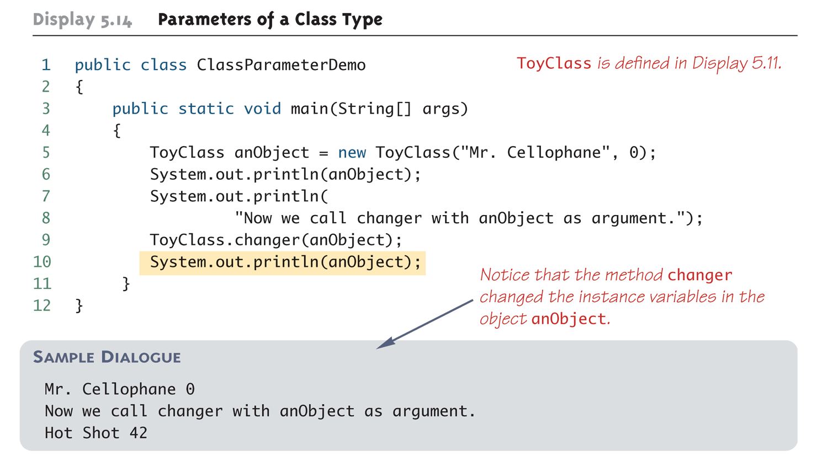
Parameters of a Class Type

Slide 46
public class ToyClass
{
private String name;
private int number;
public ToyClass(String initialName, int initialNumber)
{
name = initialName;
number = initialNumber;
}
public ToyClass( )
{
name = "No name yet.";
number = 0;
}
public void set(String newName, int newNumber)
{
name = newName;
number = newNumber;
}
public String toString( )
{
return (name + " " + number);
}
public static void changer(ToyClass aParameter)
{
aParameter.name = "Hot Shot";
aParameter.number = 42;
}
public boolean equals(ToyClass otherObject)
{
return ( (name.equals(otherObject.name))
&& (number == otherObject.number) );
}
}

Slide 47
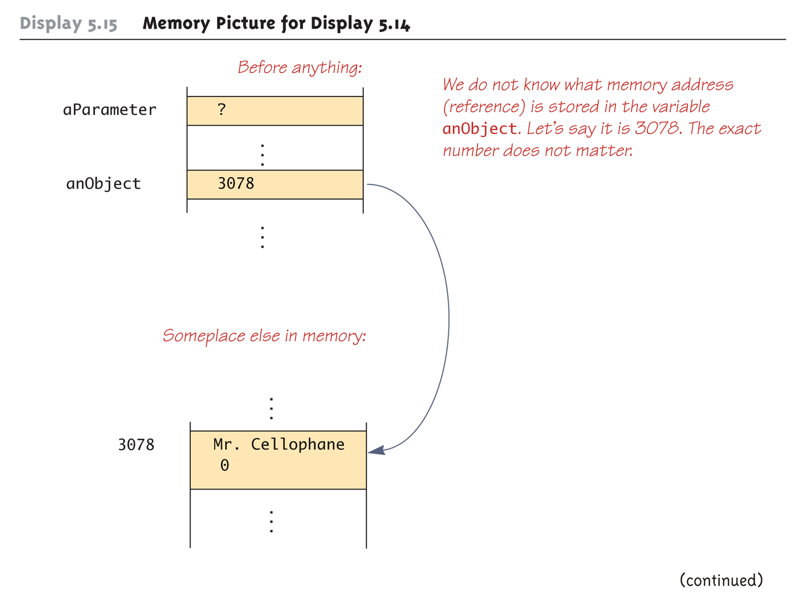
Memory Picture for Display 5.14 (Part 1 of 3)

Slide 48
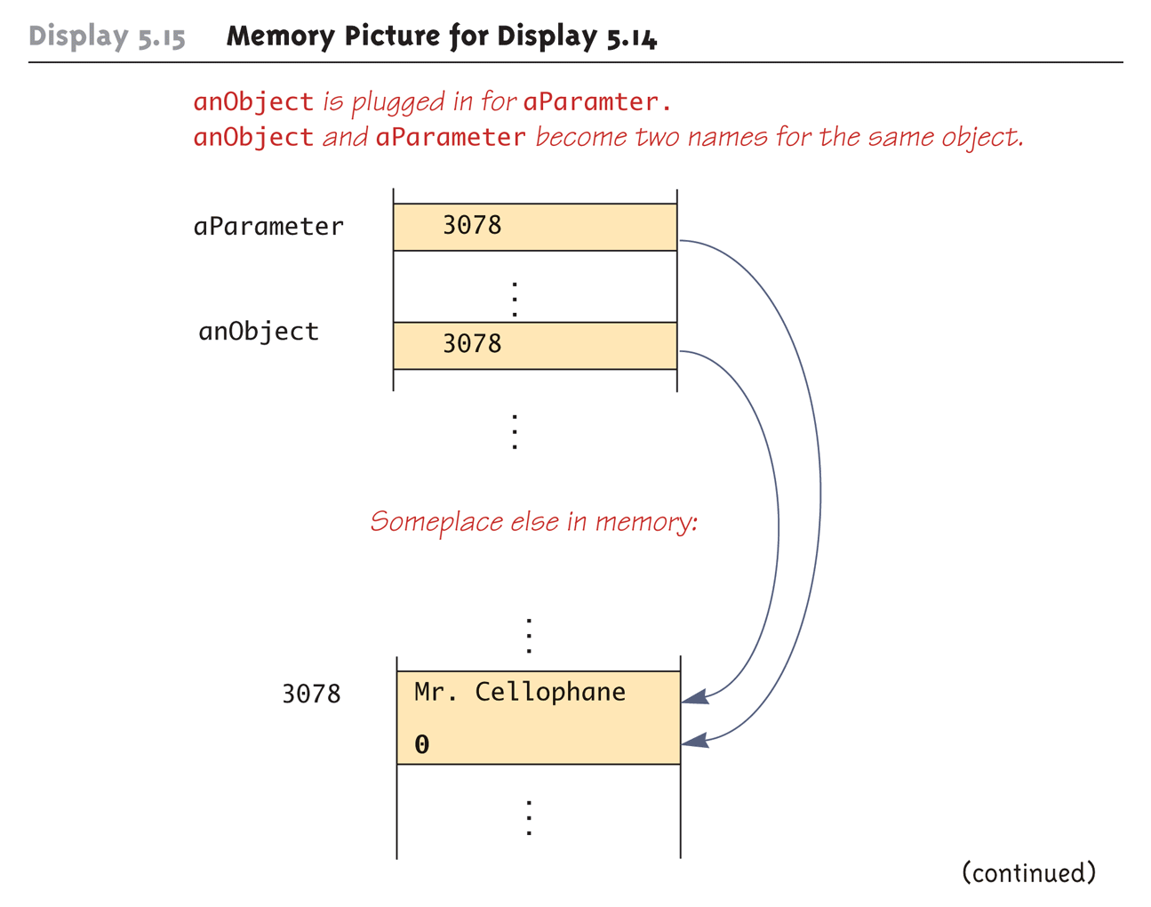
Memory Picture for Display 5.14 (Part 2 of 3)

Slide 49
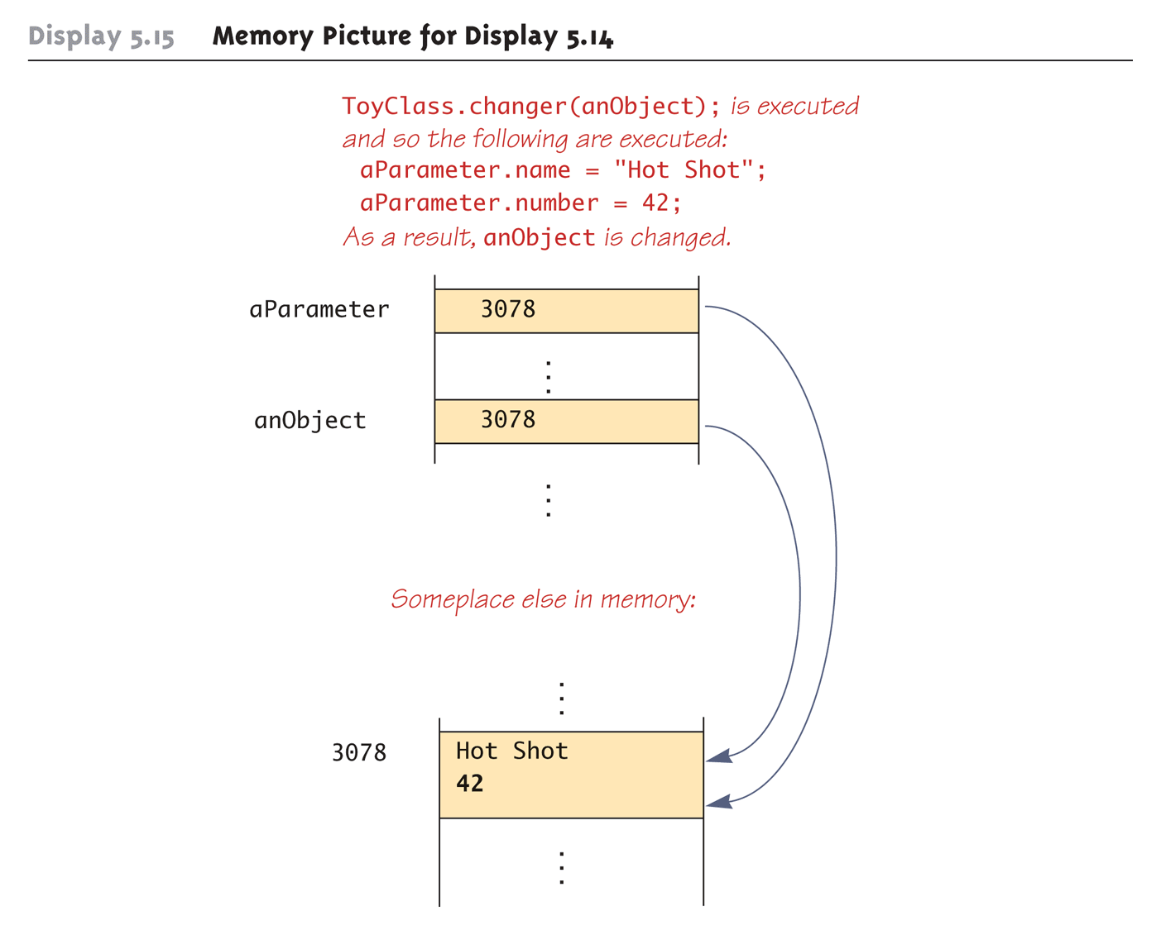
Memory Picture for Display 5.14 (Part 3 of 3)

Slide 50
Differences Between Primitive and Class-Type Parameters
A method cannot change the value of a variable of a primitive type that is an argument to the method
In contrast, a method can change the values of the instance variables of a class type that is an argument to the method

Slide 51
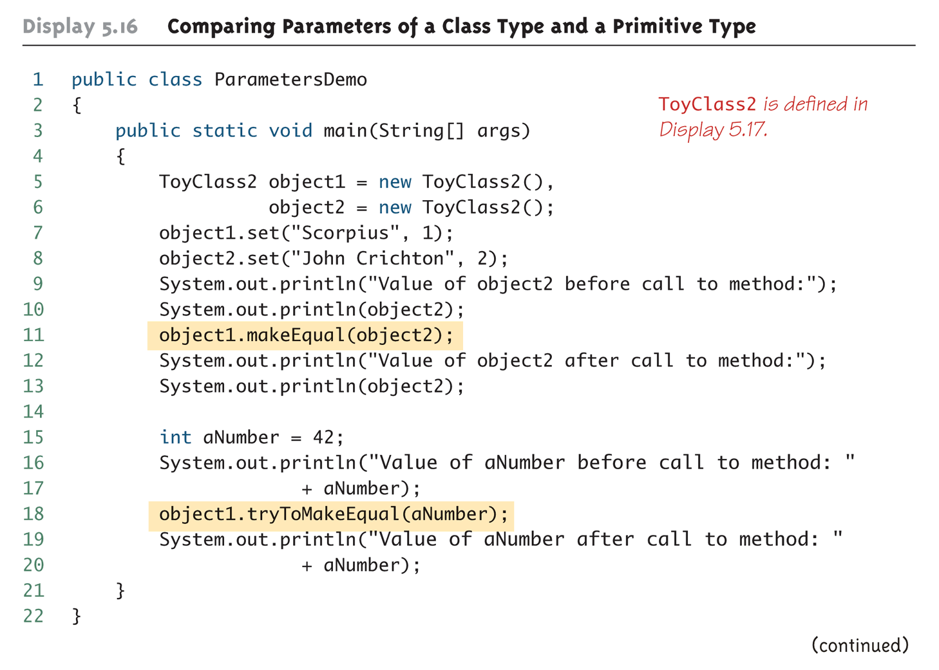
Comparing Parameters of a Class Type and a Primitive Type (Part 1 of 2)

Slide 52
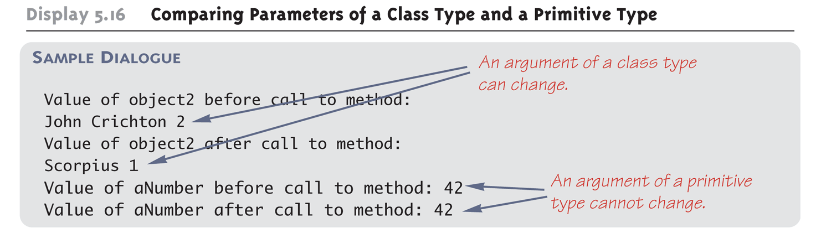
Comparing Parameters of a Class Type and a Primitive Type (Part 2 of 2)

Slide 53
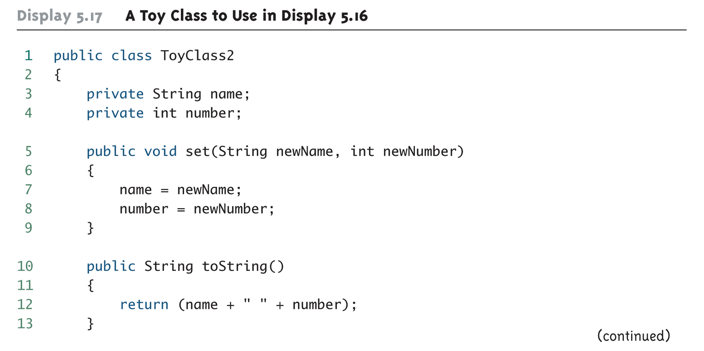
A Toy Class to Use in Display 5.16 (Part 1 of 2)

Slide 54
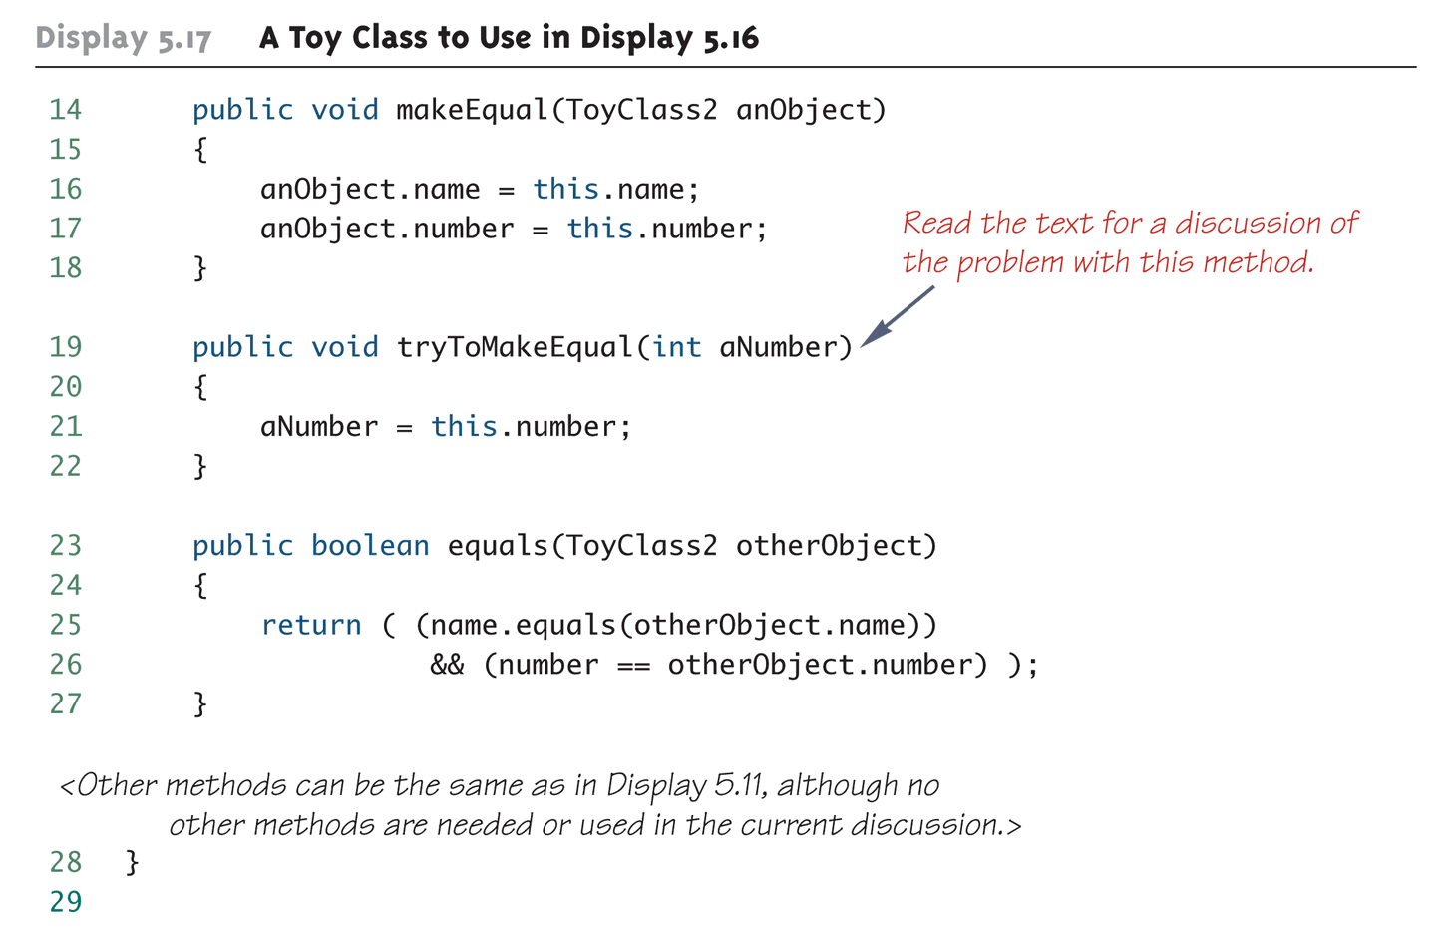
A Toy Class to Use in Display 5.16 (Part 2 of 2)

Slide 55
Pitfall: Use of = and == with Variables of a Class Type
Used with variables of a class type, the assignment operator (=) produces two variables that name the same object
This is very different from how it behaves with primitive type variables
The test for equality (==) also behaves differently for class type variables
The == operator only checks that two class type variables have the same memory address
Unlike the equals method, it does not check that their instance variables have the same values
Two objects in two different locations whose instance variables have exactly the same values would still test as being "not equal"

Slide 56
The Constant null
null is a special constant that may be assigned to a variable of any class type
YourClass yourObject = null;
It is used to indicate that the variable has no "real value"
It is often used in constructors to initialize class type instance variables when there is no obvious object to use
null is NOT an object: It is, rather, a kind of "placeholder" for a reference that does not name any memory location
Because it is like a memory address, use == or != (instead of equals) to test if a class variable contains null
if (yourObject == null) . . .

Slide 57
Pitfall: Null Pointer Exception
Even though a class variable can be initialized to null, this does not mean that null is an object
null is only a placeholder for an object
A method cannot be invoked using a variable that is initialized to null
The calling object that must invoke a method does not exist
Any attempt to do this will result in a "Null Pointer Exception" error message
For example, if the class variable has not been initialized at all (and is not assigned to null), the results will be the same

Slide 58
The new Operator
The new operator invokes a constructor which initializes an object, and returns a reference to the location in memory of the object created
This reference can be assigned to a variable of the object's class type

Slide 59
Using and Misusing References
When writing a program, it is very important to insure that private instance variables remain truly private
For a primitive type instance variable, just adding the private modifier to its declaration should insure that there will be no privacy leaks
For a class type instance variable, however, adding the private modifier alone is NOT sufficient
e.g. private Psyduck duck;

Slide 60
Designing A Person Class: Instance Variables
A simple Person class could contain instance variables
person's name (String type),
the date (Date type) on which they were born, and
the date (Date type)on which they died
As a first line of defense for privacy, each of the instance variables would be declared private
public class Person
{
private String name;
private Date born;
private Date died; //null is still alive
. . .

Slide 61
Designing a Person Class: Constructor
In order to exist, a person must have (at least) a name and a birth date
Therefore, it would make no sense to have a no-argument Person class constructor
A person who is still alive does not yet have a date of death
Therefore, the Person class constructor will need to be able to deal with a null value for date of death
A person who has died must have had a birth date that preceded his or her date of death
Therefore, when both dates are provided, they will need to be checked for consistency

Slide 62
A Person Class Constructor
public Person(String initialName, Date birthDate,
Date deathDate)
{
if (consistent(birthDate, deathDate))
{ name = initialName;
born = new Date(birthDate);
if (deathDate == null)
died = null;
else
died = new Date(deathDate);
}
else
{ System.out.println("Inconsistent dates.");
System.exit(0);
}
}

Slide 63
Designing a Person Class: the Class Invariant
/** Class invariant: A Person always has a date of birth,
and if the Person has a date of death, then the date of
death is equal to or later than the date of birth.
To be consistent, birthDate must not be null. If there
is no date of death (deathDate == null), that is
consistent with any birthDate. Otherwise, the birthDate
must come before or be equal to the deathDate.
*/
private static boolean consistent(Date birthDate, Date
deathDate)
{
if (birthDate == null) return false;
else if (deathDate == null) return true;
else return (birthDate.precedes(deathDate ||
birthDate.equals(deathDate));
}

Slide 64
Designing a Person Class: the toString Method
Like the equals method, note that the Person class toString method includes invocations of the Date class toString method
public String toString( )
{
String diedString;
if (died == null)
diedString = ""; //Empty string
else
diedString = died.toString( );
return (name + ", " + born + "-" + diedString);
}

Slide 65
Pitfall: Privacy Leaks
The previously illustrated examples from the Person class show how an incorrect definition of a constructor can result in a privacy leak
A similar problem can occur with incorrectly defined mutator or accessor methods
For example:
public Date getBirthDate()
{
return born; //dangerous
}
Instead of:
public Date getBirthDate()
{
return new Date(born); //correct
}

Slide 66
Copy Constructors
A copy constructor is a constructor with a single argument of the same type as the class
The copy constructor should create an object that is a separate, independent object, but with the instance variables set so that it is an exact copy of the argument object
Note how, in the Date copy constructor, the values of all of the primitive type private instance variables are merely copied

Slide 67
Copy Constructor for a Class with Primitive Type Instance Variables
public Date(Date aDate)
{
if (aDate == null) //Not a real date.
{
System.out.println("Fatal Error.");
System.exit(0);
}
month = aDate.month;
day = aDate.day;
year = aDate.year;
}

Slide 68
Mutable and Immutable Classes
The accessor method getName from the Person class appears to contradict the rules for avoiding privacy leaks:
public String getName()
{
return name; //Isn't this dangerous?
}
Although it appears the same as some of the previous examples, it is not: The class String contains no mutator methods that can change any of the data in a String object

Slide 69
Mutable and Immutable Classes
A class that contains no methods (other than constructors) that change any of the data in an object of the class is called an immutable class
Objects of such a class are called immutable objects
It is perfectly safe to return a reference to an immutable object because the object cannot be changed in any way
The String class is an immutable class

Slide 70
Mutable and Immutable Classes
mutable class
A class that contains public mutator methods or
other public methods that can change the data in
its objects are called mutable objects
NEVER write a method that returns a mutable object
Instead, use a copy constructor to return a reference to a completely independent copy of the mutable object

Slide 71
Packages and Import Statements
Java uses packages to form libraries of classes
A package is a group of classes that have been placed in a directory or folder, and that can be used in any program that includes an import statement that names the package
The import statement must be located at the beginning of the program file
e.g.
fcu.student.authenticaion
fcu.student.coursequery

Slide 72
package fcu.iesc.oop;
import java.util.Scanner;
public class KeyboardScanner {
public static void main(String[] args) {
Scanner keyboard = new Scanner(System.in);
System.out.print("Please enter an integer:");
int first = keyboard.nextInt();
System.out.print("Please enter a float point number:");
float second = keyboard.nextFloat();
System.out.print("Enter a you name:");
String name = keyboard.next();
System.out.printf("Hi %s, the multiplication of %d and %.5f is %.2e.", name, first, second, first * second);
keyboard.close();
}
}

Slide 73
The Package java.lang
The package java.lang contains the classes that are fundamental to Java programming
It is imported automatically, so NO import statement is needed
Classes made available by java.lang include Math, String, and the wrapper classes

Slide 74
Name Clashes (碰撞)
A situation in which two classes have the same name
Different programmers writing different packages may use the same name for one or more of their classes
This ambiguity can be resolved by using the fully qualified name (i.e., precede the class name by its package name) to distinguish between each class
package_name.ClassName
If the fully qualified name is used, it is no longer necessary to import the class

